Slide 1
Surface reaction
Heterogeneous catalytic reaction mechanisms

Slide 2
Adsorption of reactant is necessary for a reaction to happen on a solid catalyst.
Once a reactant is adsorbed on a solid catalytic surface, it can react in a number of ways to form product(s).
Consider a chemical reaction A <=> B,
The adsorption of species A onto a solid catalyst surface is shown as,
A + S <=> A.S, where S is a vacant site
Then reaction step on the solid catalyst surface can be written as,
A.S <=> B.S
If the reaction is A + B <=> C + D, then adsorption step is
A + B + 2S <=> A.S + B.S

Slide 3
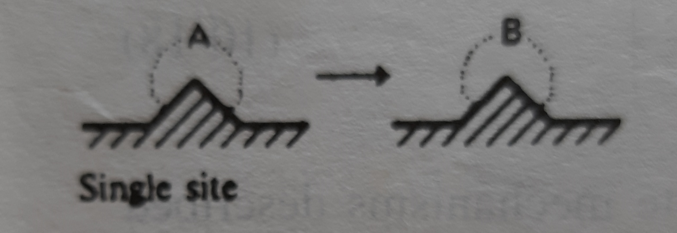
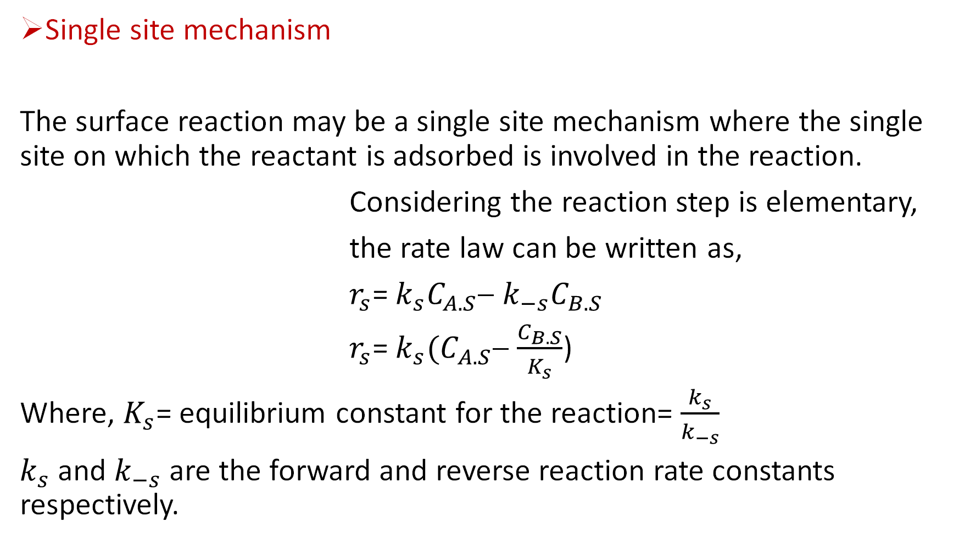
Single site mechanism
The surface reaction may be a single site mechanism where the single site on which the reactant is adsorbed is involved in the reaction.
Considering the reaction step is elementary,
the rate law can be written as,
$r_{s}$= $k_{s}C_{A.S}$− $k_{−s}C_{B.S}$
$r_{s}$= $k_{s}{(C}_{A.S}$− $\frac{C_{B.S}}{K_{s}}$)
Where, $K_{s}$= equilibrium constant for the reaction= $\frac{k_{s}}{k_{−s}}$
$k_{s}$ and $k_{−s}$ are the forward and reverse reaction rate constants respectively.

Slide 4
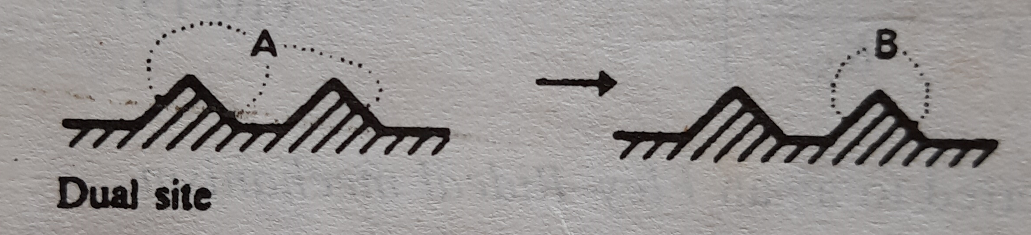
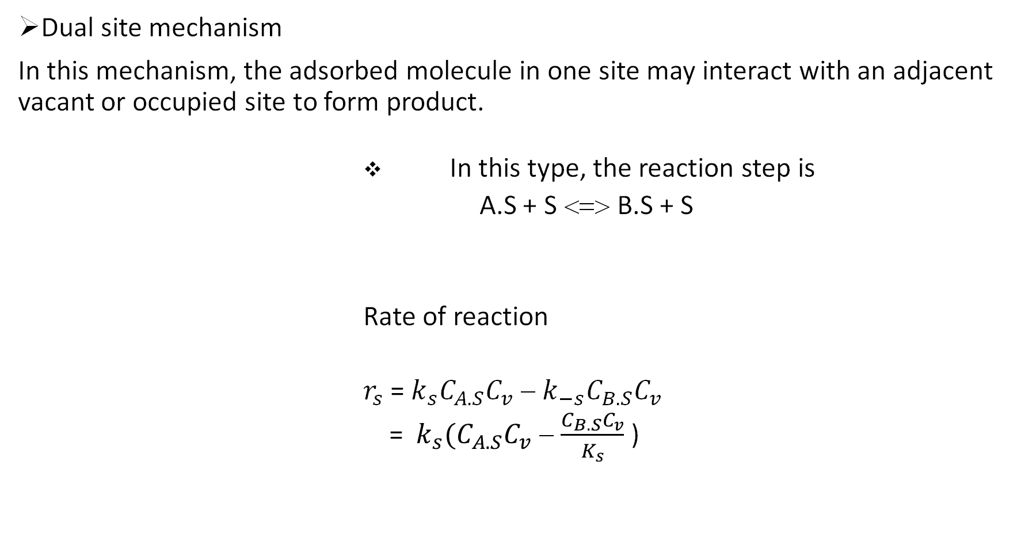
Dual site mechanism
In this mechanism, the adsorbed molecule in one site may interact with an adjacent vacant or occupied site to form product.
In this type, the reaction step is
A.S + S <=> B.S + S
Rate of reaction
$r_{s}$ = $k_{s}C_{A.S}C_{v}$ − $k_{−s}C_{B.S}C_{v}$
= $k_{s}{(C}_{A.S}C_{v}$ − $\frac{C_{B.S}C_{v}}{K_{s}}$ )

Slide 5
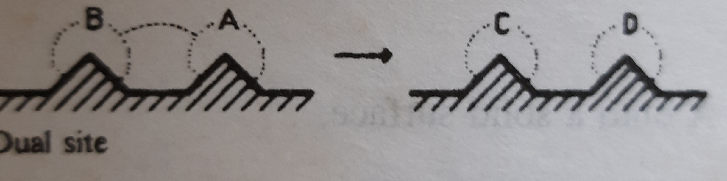
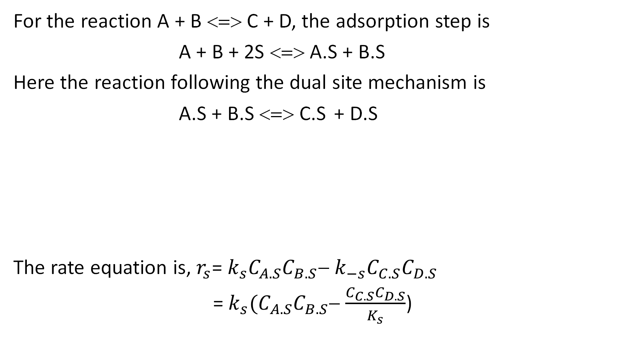
For the reaction A + B <=> C + D, the adsorption step is
A + B + 2S <=> A.S + B.S
Here the reaction following the dual site mechanism is
A.S + B.S <=> C.S + D.S
The rate equation is, $r_{s}$= $k_{s}C_{A.S}C_{B.S}$− $k_{−s}C_{C.S}C_{D.S}$
= $k_{s}{(C}_{A.S}C_{B.S}$− $\frac{C_{C.S}C_{D.S}}{K_{s}}$)

Slide 6
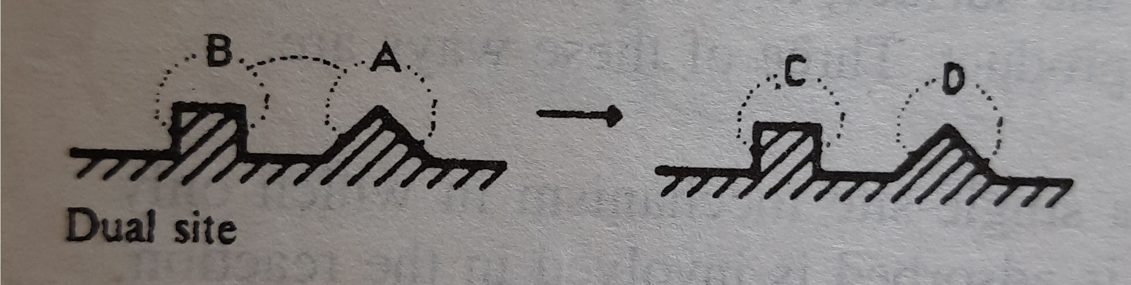
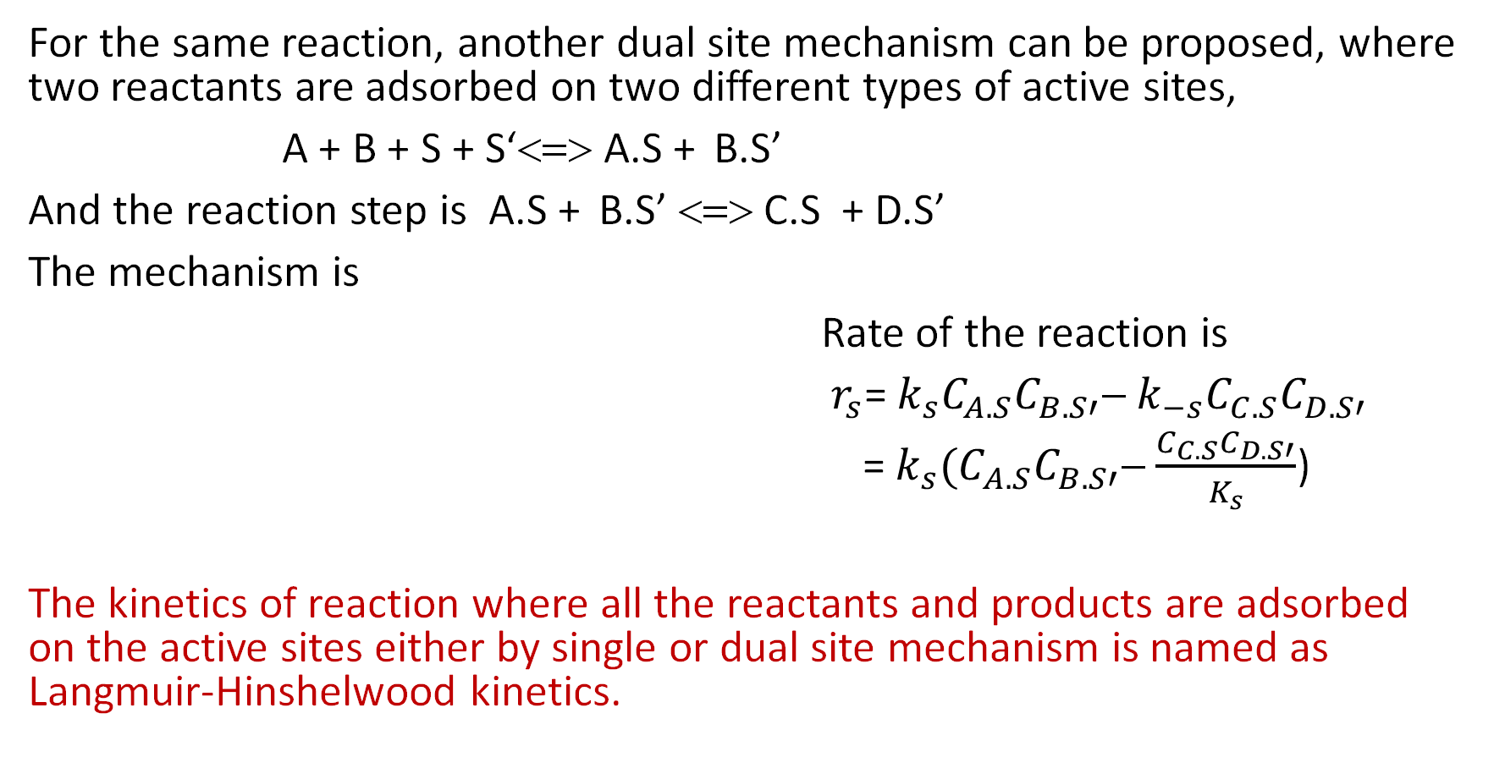
For the same reaction, another dual site mechanism can be proposed, where two reactants are adsorbed on two different types of active sites,
A + B + S + S‘<=> A.S + B.S’
And the reaction step is A.S + B.S’ <=> C.S + D.S’
The mechanism is
Rate of the reaction is
$r_{s}$= $k_{s}C_{A.S}C_{B.S′}$− $k_{−s}C_{C.S}C_{D.S′}$
= $k_{s}{(C}_{A.S}C_{B.S′}$− $\frac{C_{C.S}C_{D.S′}}{K_{s}}$)
The kinetics of reaction where all the reactants and products are adsorbed on the active sites either by single or dual site mechanism is named as Langmuir-Hinshelwood kinetics.

Slide 7
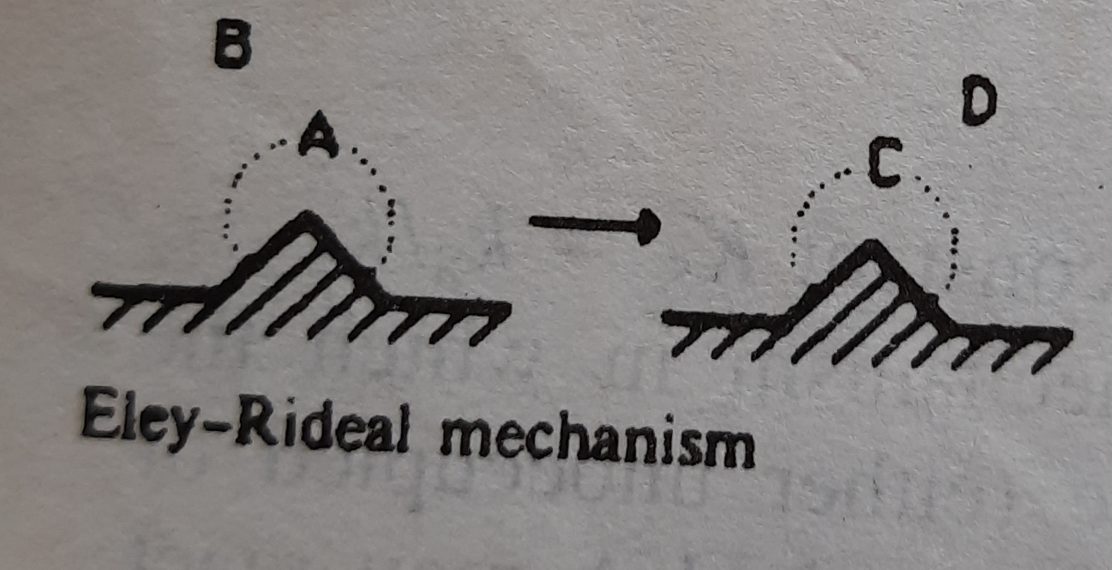
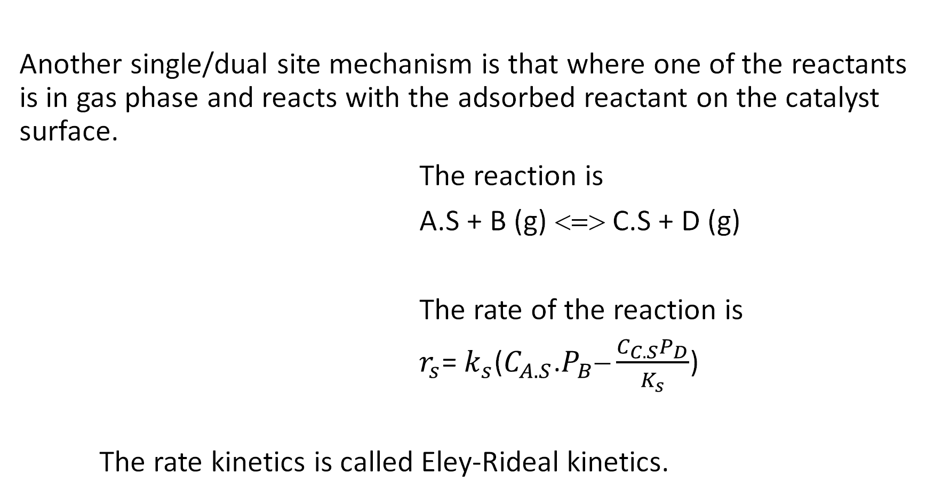
Another single/dual site mechanism is that where one of the reactants is in gas phase and reacts with the adsorbed reactant on the catalyst surface.
The reaction is
A.S + B (g) <=> C.S + D (g)
The rate of the reaction is
$r_{s}$= $k_{s}$($C_{A.S}$.$P_{B}−\frac{C_{C.S}P_{D}}{K_{s}}$)
The rate kinetics is called Eley-Rideal kinetics.

Slide 8
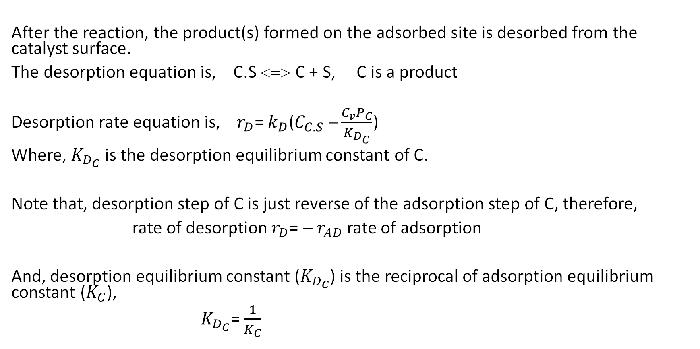
Desorption
After the reaction, the product(s) formed on the adsorbed site is desorbed from the catalyst surface.
The desorption equation is, C.S <=> C + S, C is a product
Desorption rate equation is, $r_{D}$= $k_{D}$($C_{C.S} −\frac{C_{v}P_{C}}{K_{D_{C}}}$)
Where, $K_{D_{C}}$ is the desorption equilibrium constant of C.
Note that, desorption step of C is just reverse of the adsorption step of C, therefore,
rate of desorption $r_{D}$= $$ $r_{AD}$ rate of adsorption
And, desorption equilibrium constant ($K_{D_{C}}$) is the reciprocal of adsorption equilibrium constant ($K_{C}$),
$K_{D_{C}}$= $\frac{1}{K_{C}}$

Slide 9
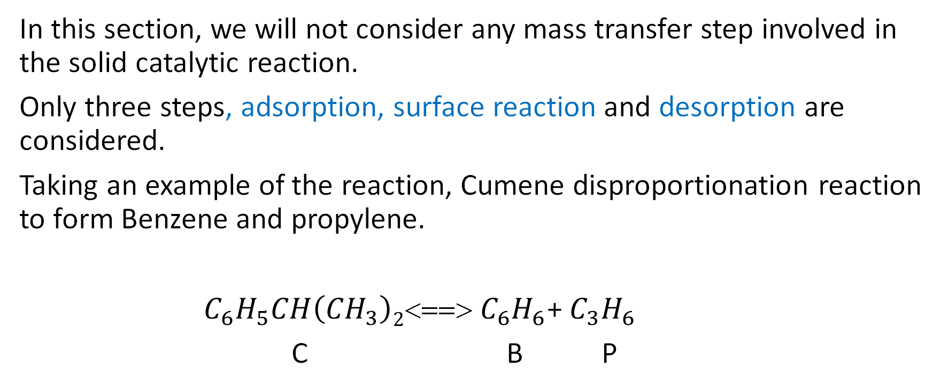
Synthesising a Rate law, Mechanism and Rate limiting Step:
In this section, we will not consider any mass transfer step involved in the solid catalytic reaction.
Only three steps, adsorption, surface reaction and desorption are considered.
Taking an example of the reaction, Cumene disproportionation reaction to form Benzene and propylene.
$C_{6}H_{5}CH\left({CH}_{3}\right)2$<==> $C_{6}H_{6}$+ $C_{3}H_{6}$
C B P

Slide 10
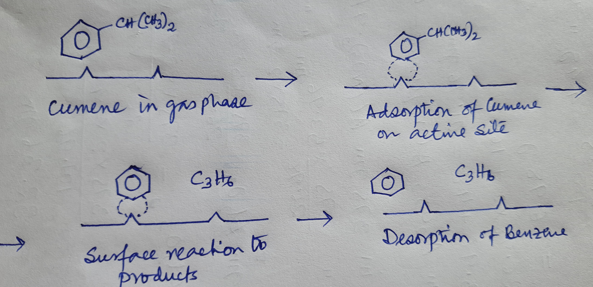
Sequence of steps:

Slide 11
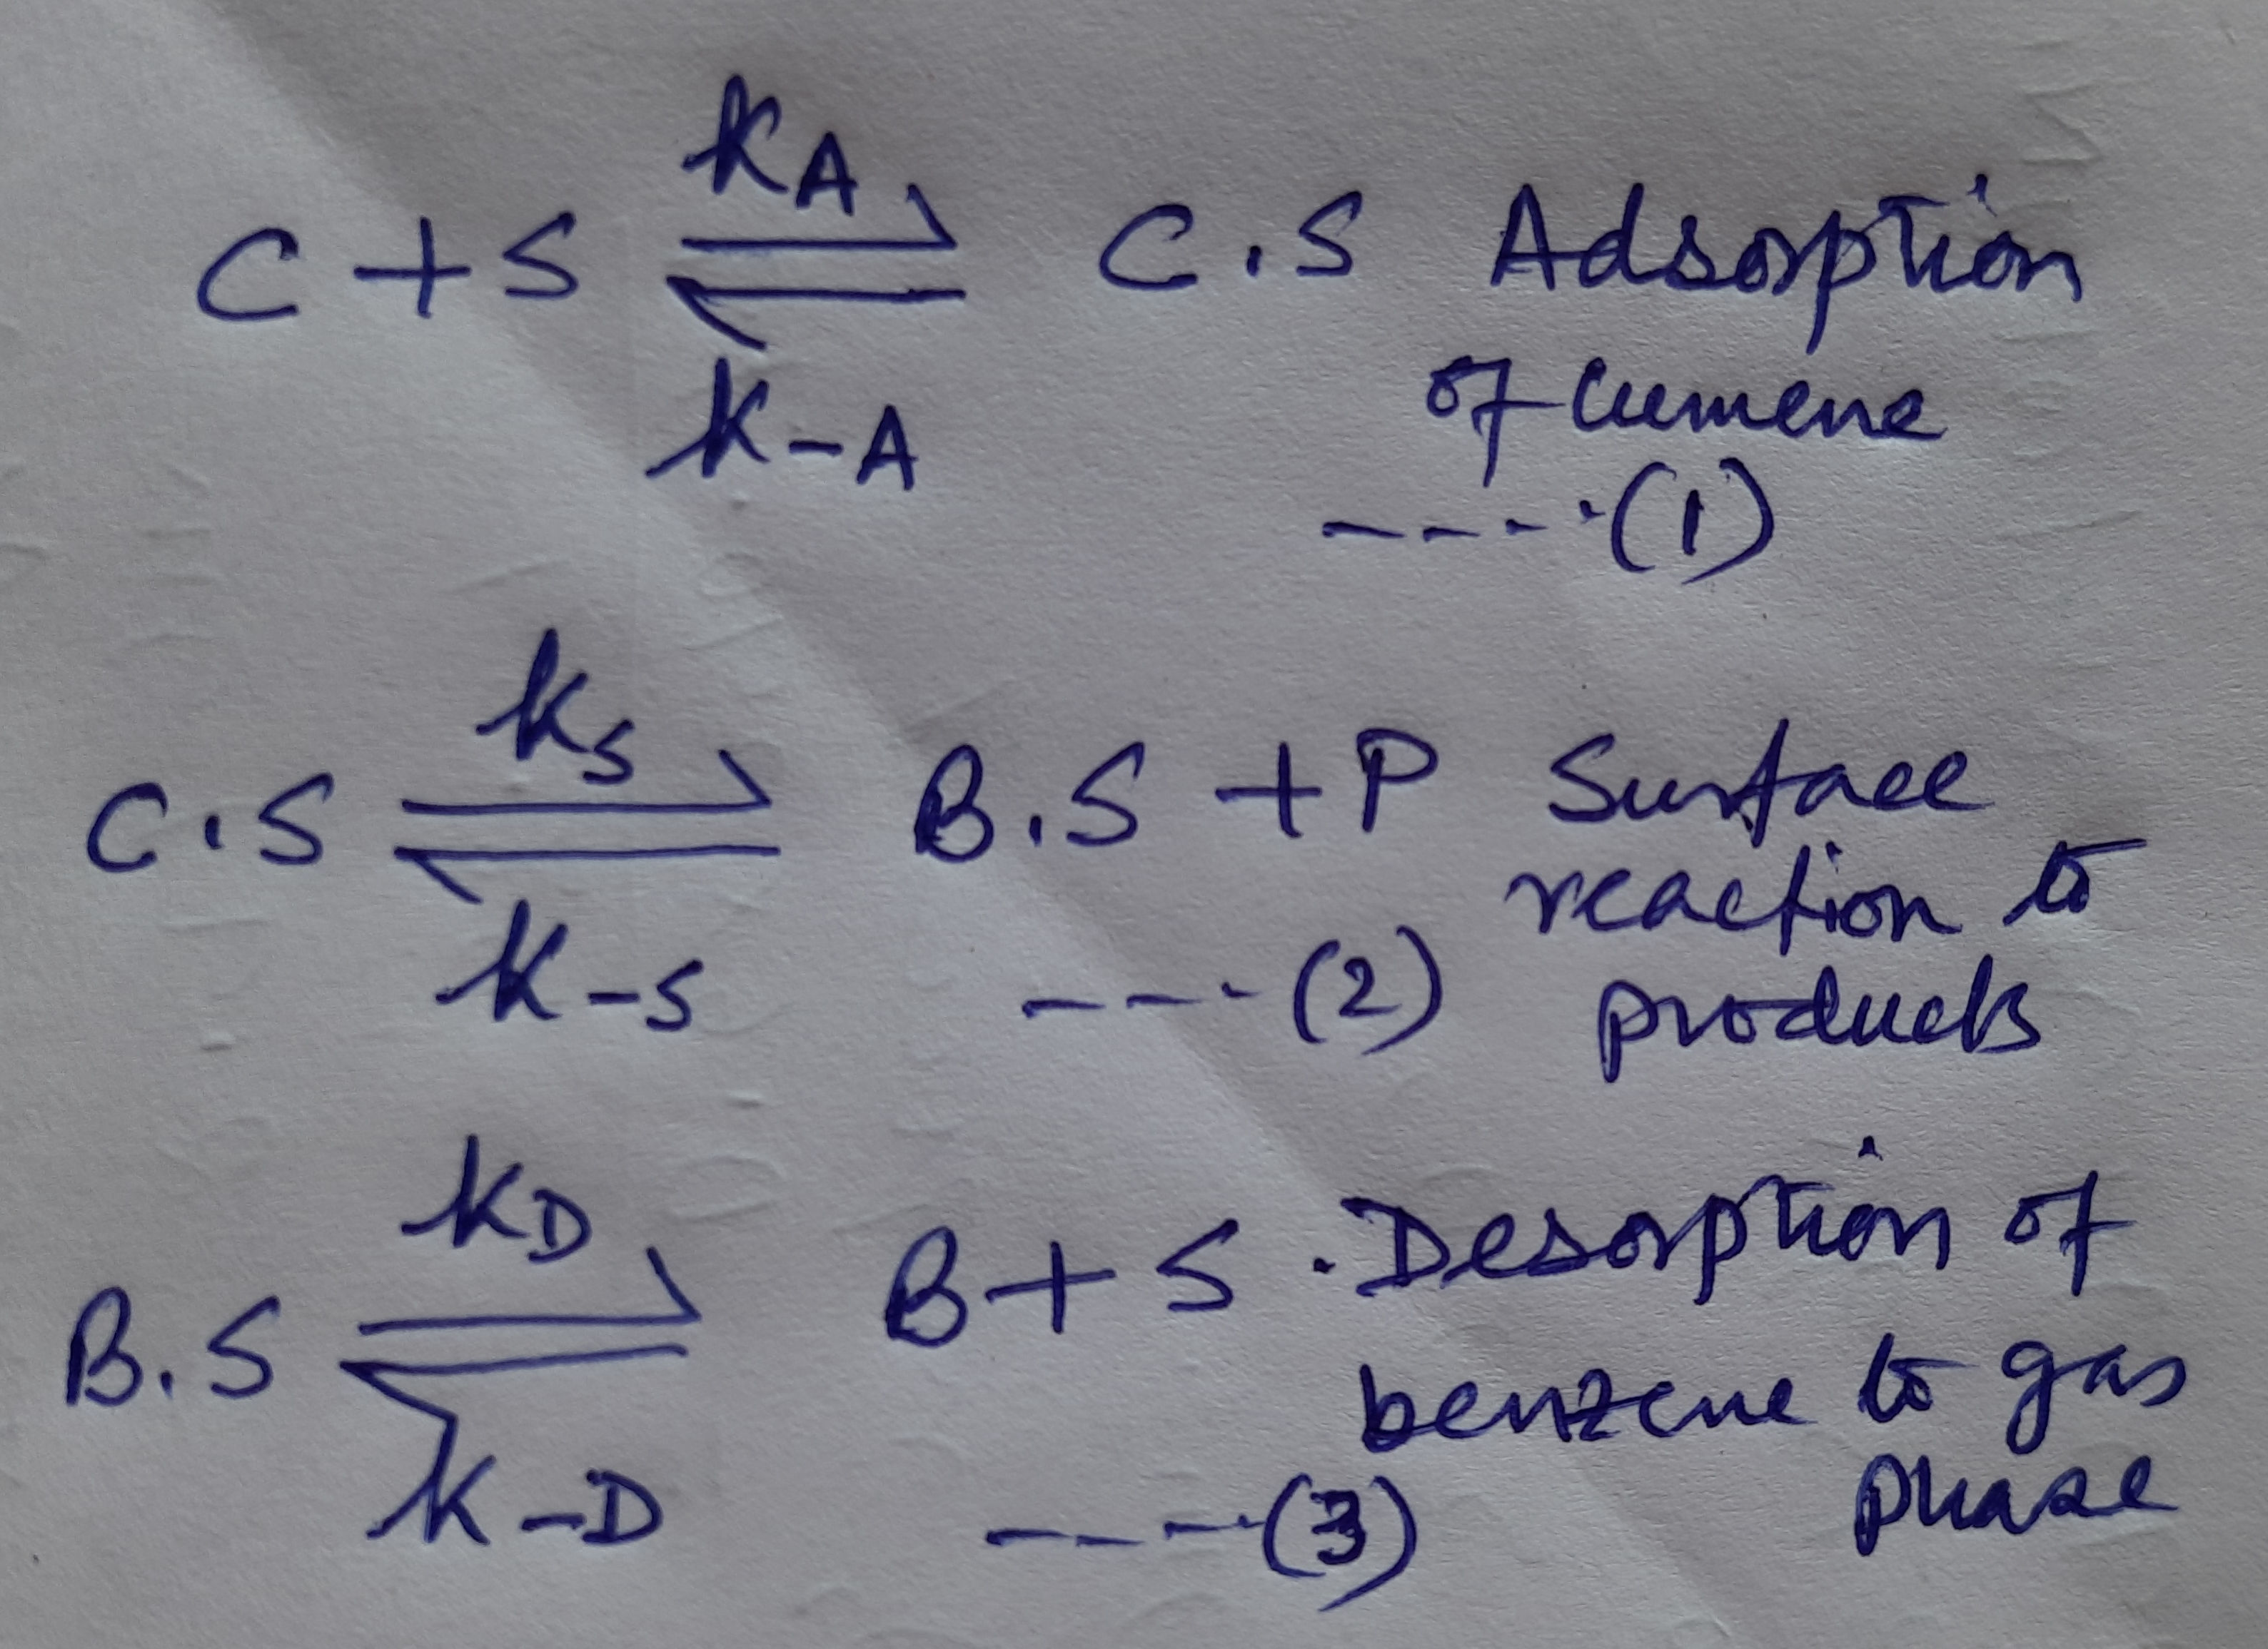
Contd…
The reaction can be written as,
All the steps are treated as
elementary steps.
For gas reactants the concentrations
will be expressed in partial pressures

Slide 12
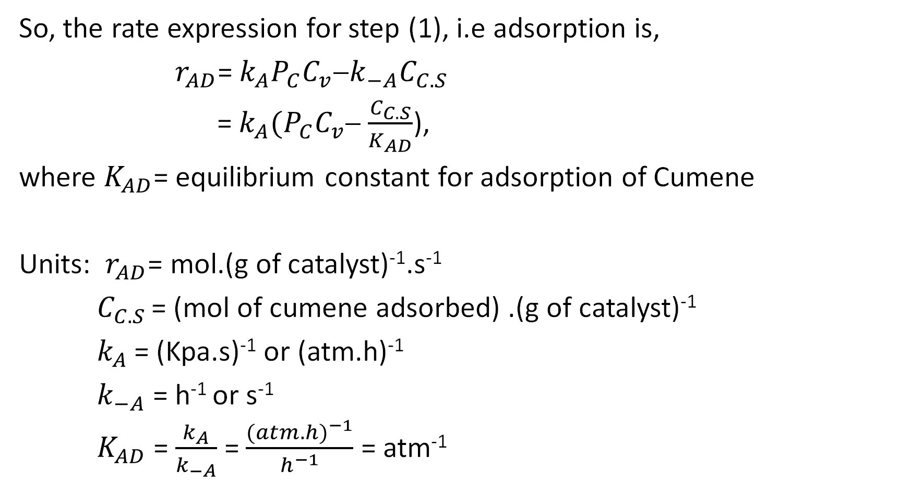
So, the rate expression for step (1), i.e adsorption is,
$r_{AD}$= $k_{A}P_{C}C_{v}$−$k_{−A}C_{C.S}$
= $k_{A}{(P}_{C}C_{v}$− $\frac{C_{C.S}}{K_{AD}}$),
where $K_{AD}$= equilibrium constant for adsorption of Cumene
Units: $r_{AD}$= mol.(g of catalyst)⁻¹.s⁻¹
$C_{C.S}$ = (mol of cumene adsorbed) .(g of catalyst)⁻¹
$k_{A}$ = (Kpa.s)⁻¹ or (atm.h)⁻¹
$k_{−A}$= h⁻¹ or s⁻¹
$K_{AD}$ = $\frac{k_{A}}{k_{−A}}$ = $\frac{{(atm.h)}^{−1}}{h^{−1}}$ = atm⁻¹

Slide 13
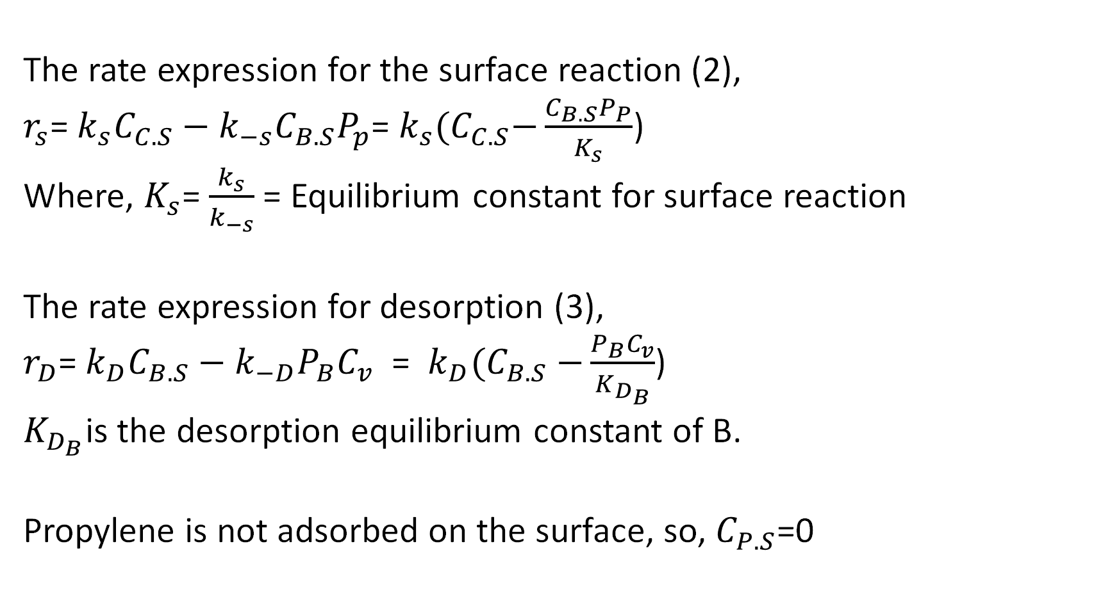
The rate expression for the surface reaction (2),
$r_{s}$= $k_{s}C_{C.S}−k_{−s}C_{B.S}P_{p}$= $k_{s}{(C}_{C.S}−\frac{C_{B.S}P_{P}}{K_{s}}$)
Where, $K_{s}$= $\frac{k_{s}}{k_{−s}}$ = Equilibrium constant for surface reaction
The rate expression for desorption (3),
$r_{D}$= $k_{D}C_{B.S}−k_{−D}P_{B}C_{v}$ = $k_{D}{(C}_{B.S}$ $−\frac{P_{B}C_{v}}{K_{D_{B}}}$)
$K_{D_{B}}$is the desorption equilibrium constant of B.
Propylene is not adsorbed on the surface, so, $C_{P.S}$=0

Slide 14
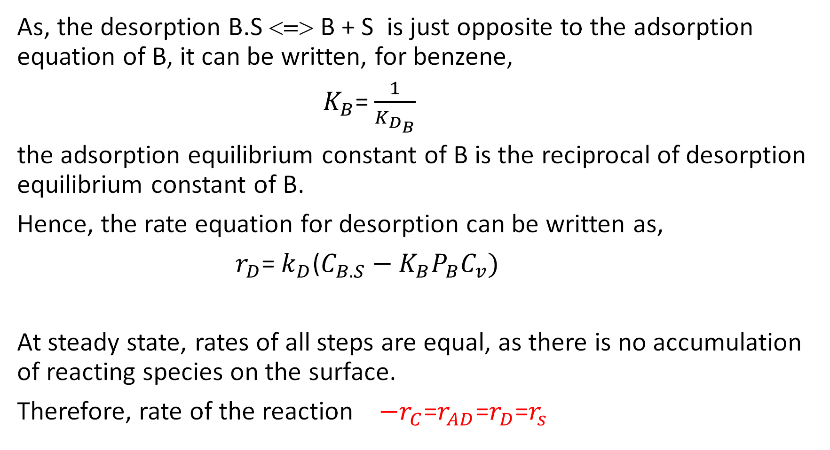
As, the desorption B.S <=> B + S is just opposite to the adsorption equation of B, it can be written, for benzene,
$K_{B}$= $\frac{1}{K_{D_{B}}}$
the adsorption equilibrium constant of B is the reciprocal of desorption equilibrium constant of B.
Hence, the rate equation for desorption can be written as,
$r_{D}$= $k_{D}$($C_{B.S}−K_{B}P_{B}C_{v})$
At steady state, rates of all steps are equal, as there is no accumulation of reacting species on the surface.
Therefore, rate of the reaction ${−r}_{C}$=$r_{AD}$=$r_{D}$=$r_{s}$

